Slide 1

An update
06/24/2014

Slide 2
Objectives and Components
Objectives
To identify novel risk raising genes and alleles for late-onset Alzeihmer’s Disease (LOAD), and
To identify novel protective genes and alleles for late-onset Alzeihmer’s Disease (LOAD), and
Components
Family-based sequencing (584 subjects; WGS; March 2013 - January 2014)
Case-Control sequencing (5,000 case and control; WES; June 2013 - August 2014)
Replication and Validation (50,000 samples are targeted; January 2014 - March 2015)
Deep targeted sequencing of candidate AD (December 2014 - Summer 2015)

Slide 3
Alzheimer’s Disease
Alzheimer's disease is an irreversible, progressive brain disease.
Characterized by:
development of amyloid plaques and neurofibrillary tangles,
the loss of connections between nerve cells, or neurons, in the brain, and
the death of these nerve cells
Two types of Alzheimer’s:
Early-onset
Late-onset

Slide 4
Late-Onset Alzheimer’s Disease
LOAD makes up the majority of the cases of Azheimer’s Diseas; onset of LOAD is over 60 years of age
Has a strong genetic component
Predominant means of identification of risk loci near or within genes has been through GWAS studies
Both rare and common variants have been identified; variants in genes implicate genes involved in lipid metabolism, the inflammatory response, and endocytosis
Three pathways have been implicated thus far: Cholesterol Metabolism, Immune Response and Endocytosis,

Slide 5
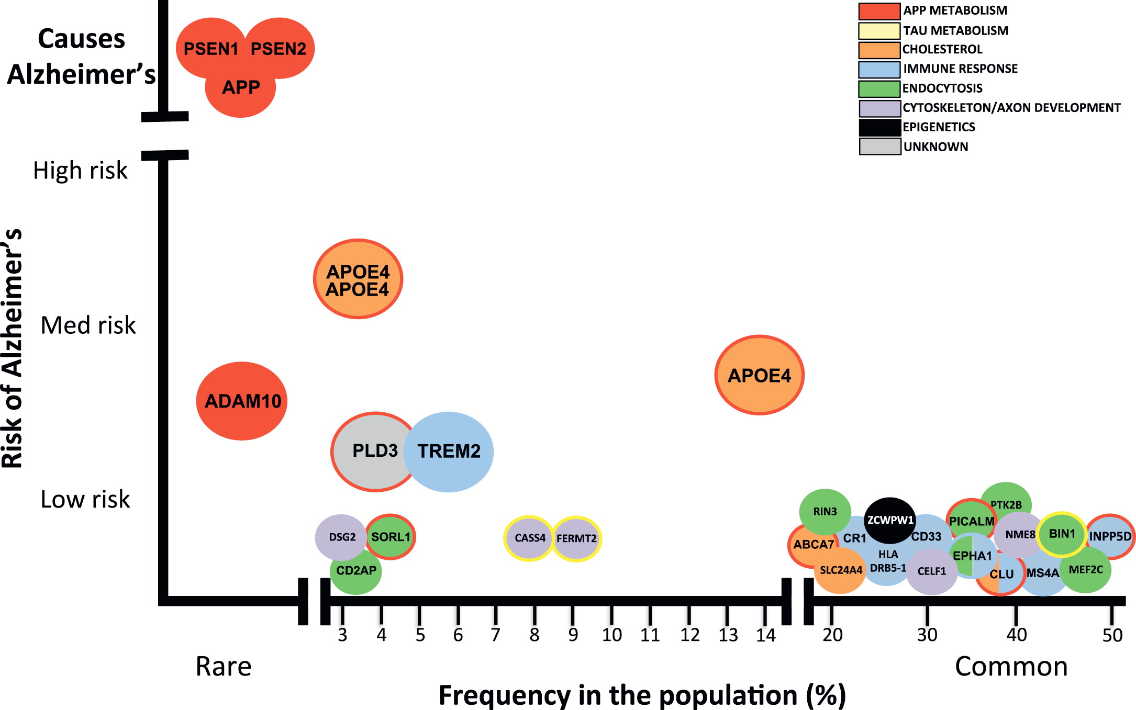
Late-Onset Alzheimer’s Disease
Alzheimer’s Disease Risk Genes and Mechanisms of Disease Pathogenesis, Celeste M. Karch and Alison M. Goate; BIOL PSYCHIATRY 2014;

Slide 6
ADSP Summary
4 = African Amreican; 5=Caucasian; 6=other
A total of 584 subjects across 111 families have been sequenced

Slide 7



Analysis Workflow
deduped bam -> realigned, recalibrated bam
SRA->bam
bam -> deduped bam
whole genome variant calling
variant filtering (soft)
snpEFF annotations
GATK3.1

Slide 8
Current Status
FamiliyID | DefAD | NoAD | Other | PossAD | ProbAD | Unknown
CU0026F | 0 | 3 | 0 | 1 | 7 | 0
CU0039F | 0 | 1 | 0 | 3 | 4 | 0
LD1223F | 1 | 1 | 0 | 1 | 4 | 0
LD1265F | 4 | 1 | 0 | 0 | 0 | 0

Slide 9
Current Status …
14/31 WGS samples completed
Process the soft filtered variants by looking at the 21 LOAD GWAS loci
Start the next batch

